Slide 1

Weather Image Recognition System
Vishal Balaji Kotrike (EE36010)

Slide 2
INTRODUCTION
Description:
The project focuses on creating an advanced weather image recognition system by utilizing modern methods such as image recognition and machine learning.
Successfully implemented a robust system capable of accurately identifying and categorizing diverse weather conditions depicted in images.
The project holds substantial significance by improving meteorological predictions, fortifying disaster response, and contributing to environmental monitoring efforts.
Problem statement:
Our work gains importance in the face of increasing weather-related incidents, providing valuable contributions to the fields of meteorology and disaster management.

Slide 3
Implemented Tasks
Data gathered from Kaggle
Imported Python Libraries like Pyspark, Matplot.lib, tensorflow etc.
Trained Evaluated and gathered evaluation results like accuracy
Completed data collection for training the image recognition model.
Successfully created and trained the initial version of the image recognition algorithm.
Evaluated the dataset accuracy
Used efficientnetb3 model from keras

Slide 4
Adjustments made since Defense/Report
Instead of Tableau for visualizations used Matplotlib python library.
Facing issues while storing data in Mongodb

Slide 5
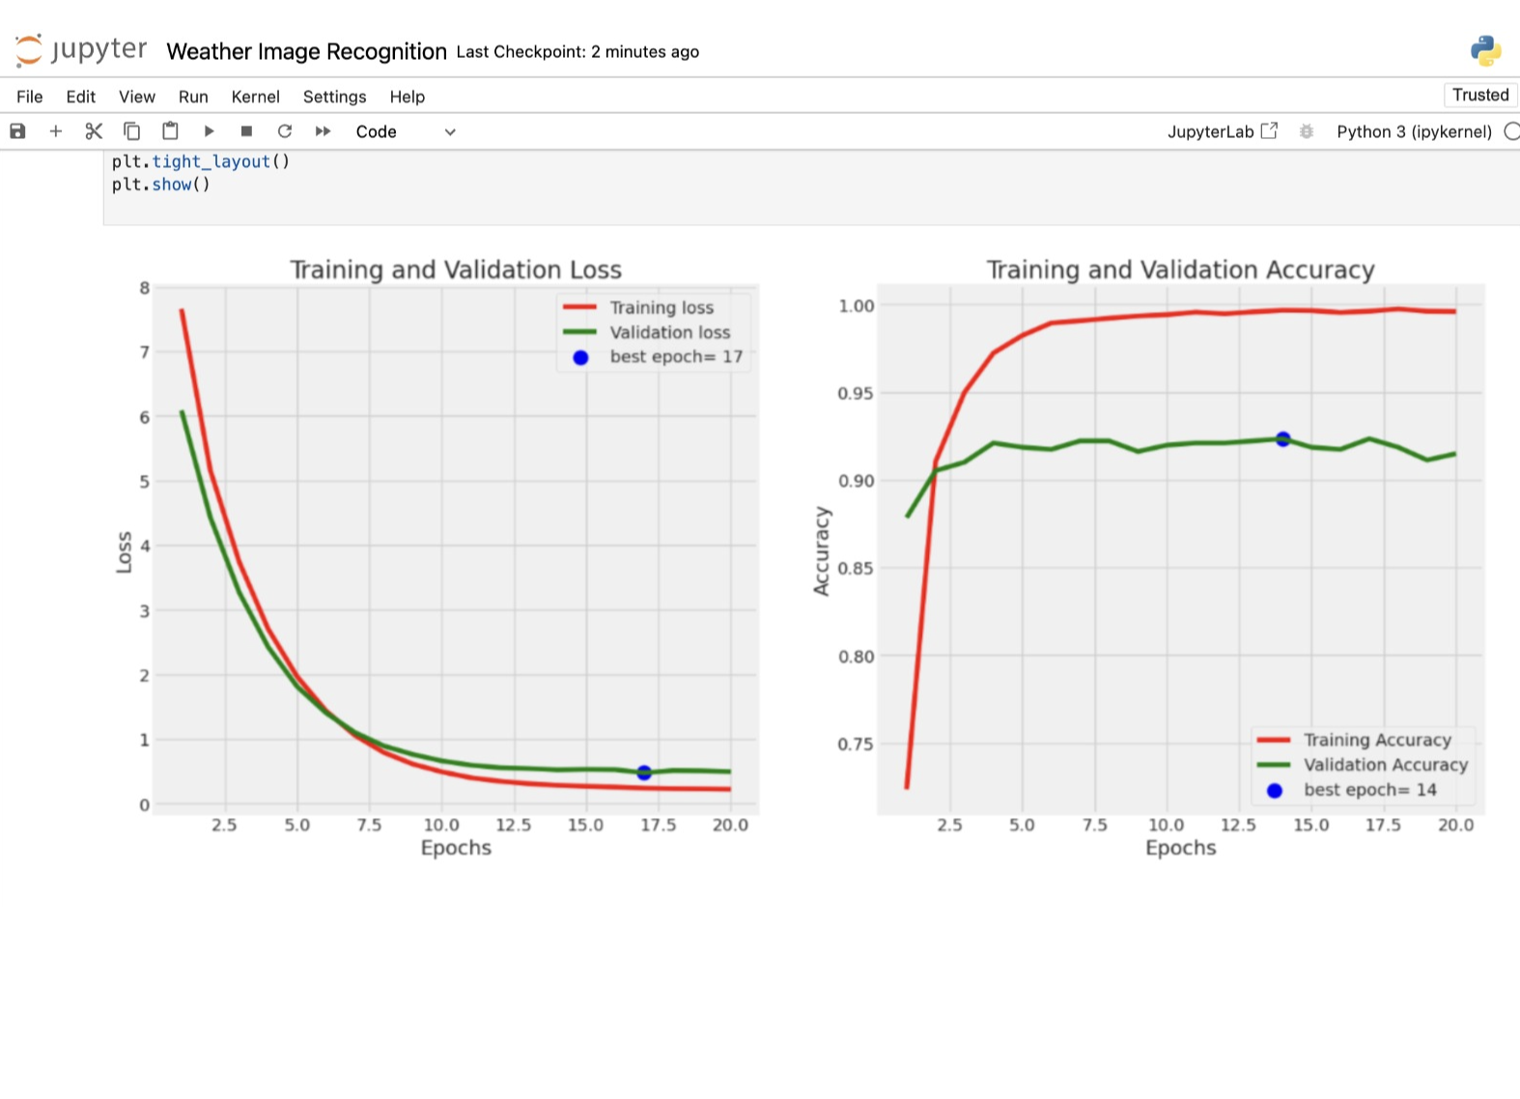
Results for Model Performance

Slide 6
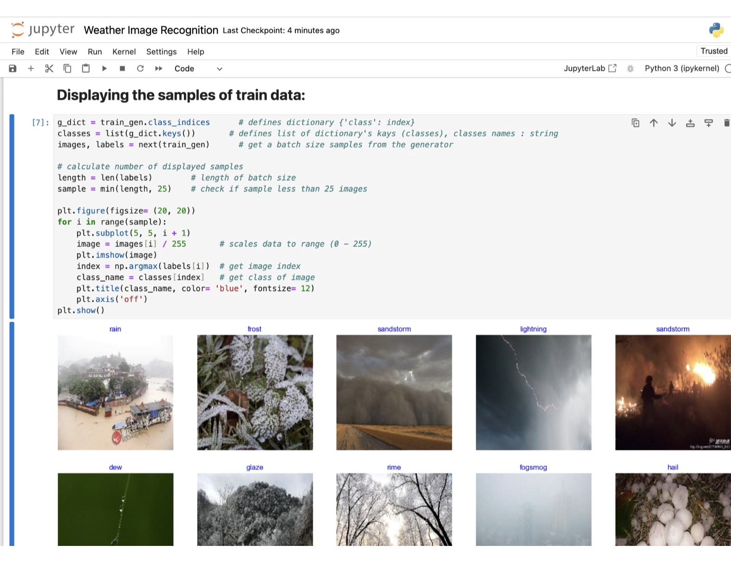
Results for Image Training

Slide 7
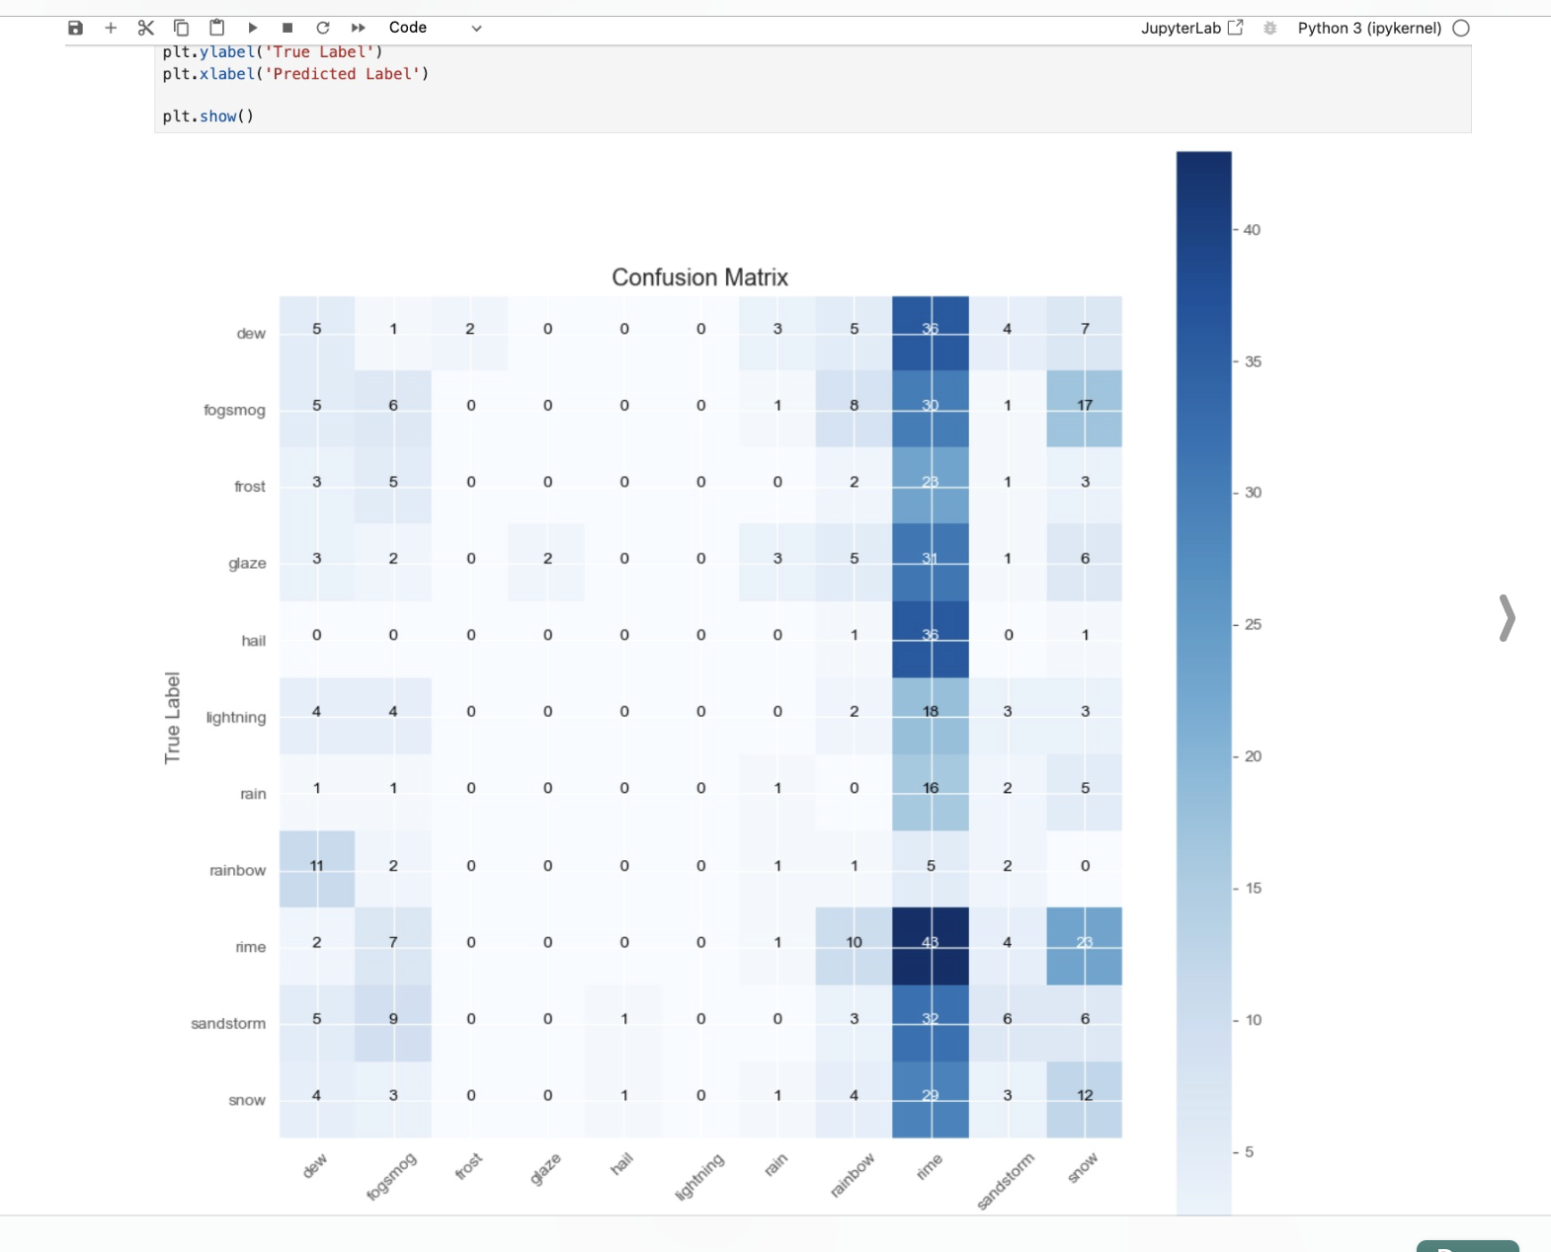
Confusion matrix

Slide 8
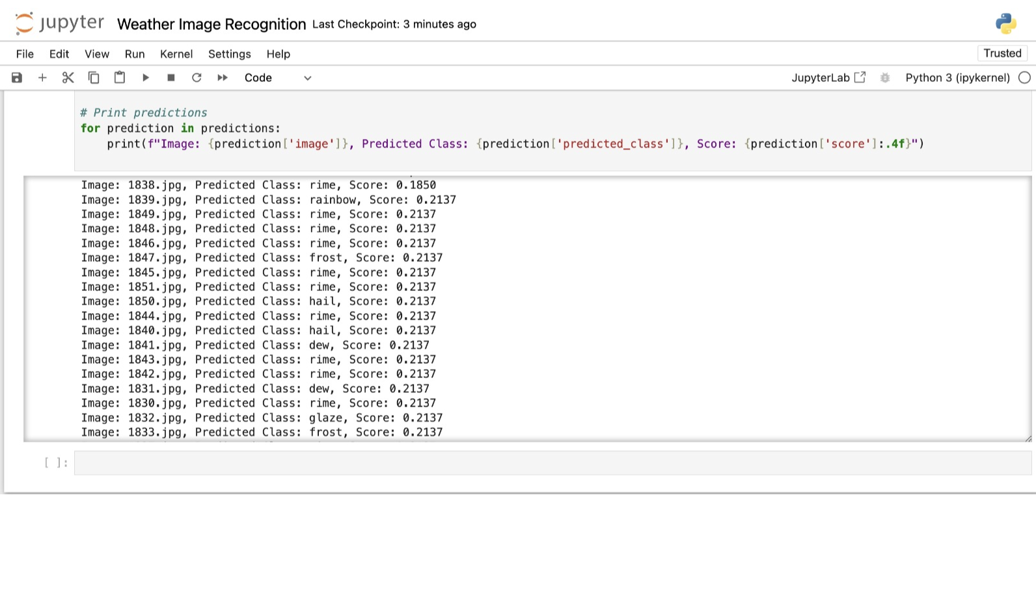
Results for Predictions

Slide 9
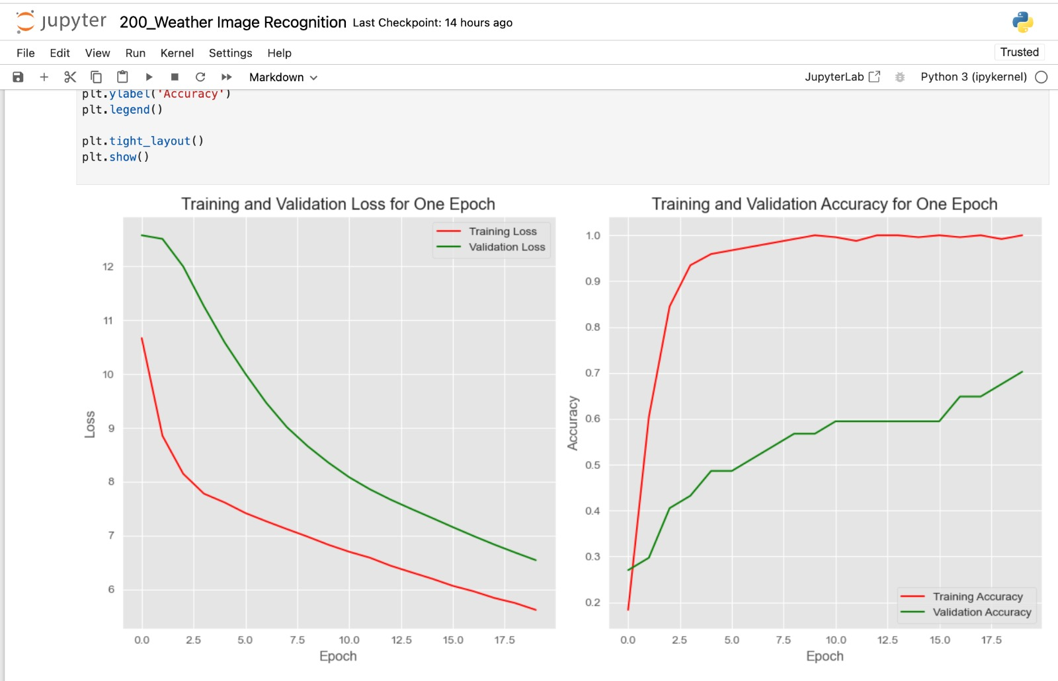
EVALUATION OF MODEL (200 IMAGES)

Slide 10
Conclusion
Our Weather Image Recognition project marks a significant step forward in harnessing machine learning and computer vision to understand and interpret diverse weather conditions.
We faced and conquered challenges in making our system better, dealing with issues in accuracy and flexibility.
What we did matters in the real world. Better weather image predictions mean better responses to disasters, helping everyone stay safe.
Through this project, we've not only achieved our objectives but also gained valuable insights into the intricacies of image recognition system. We are taking these lessons to keep making things better in the future.

Slide 11
Lessons Learned
Collaborating across domains, such as machine learning, computer vision, and meteorology, highlighted the importance of interdisciplinary teamwork.
Emphasized the critical role of high-quality data in model training and the impact on overall system performance.
Faced challenges in interpreting complex machine learning models, leading to a greater appreciation for explainable AI approaches.
Learned the significance of designing models that can adapt effectively to diverse and dynamic datasets, reflecting real-world scenarios.
Recognized the iterative nature of model development, understanding the need for continuous improvement based on feedback and evolving requirements.

Slide 12
Reference
“Weather Dataset Source(Kaggle)” by Jehan Bhatena: https://www.kaggle.com/datasets/jehanbhathena/weather-dataset
“Image Segmentation on Apache Spark” by Geraldo Souza: https://towardsdatascience.com/image-segmentation-on-apache-spark-46164dd53c73
“Deep Learning for Image Classification” by John Smith: https://viso.ai/computer-vision/image-classification/
“Weather Image Analysis Techniques” by Zenghui Wang:
https://dl.acm.org/doi/fullHtml/10.1145/3556677.3556688

Slide 13
Thank you

